Slide 1

Customer personality analysis
Group Number :- 4
Group Members :- Rani Hasitha
Nukam madhan
Jetty Sai Deekshith
Eleti Maheshwari
Aithamoni Varun Tej

Slide 2
Background :
Customer Personality Analysis is a detailed analysis of a company’s ideal customers. It helps a business to better understand its customers and makes it easier for them to modify products according to the specific needs, behaviors and concerns of different types of customers.
Customer personality analysis helps a business to modify its product based on its target customers from different types of customer segments

Slide 3

Objective :-
our objective is to predict the customer personality based on the remaining attributes of the data sets
THE PATH :- a data set is considered to predict customer personality through the parameters like income , education , marital status , etc.
Dataset is downloaded from the link :- https://www.kaggle.com/datasets/imakash3011/customer-personality-analysis

Slide 4
data and data quality check
In this data we have 2240 rows and 29 columns
Attributes present in the data are income, education , marital status , etc.
We analysed customer personality by comparing accuracy between logistic regression and random forest

Slide 5
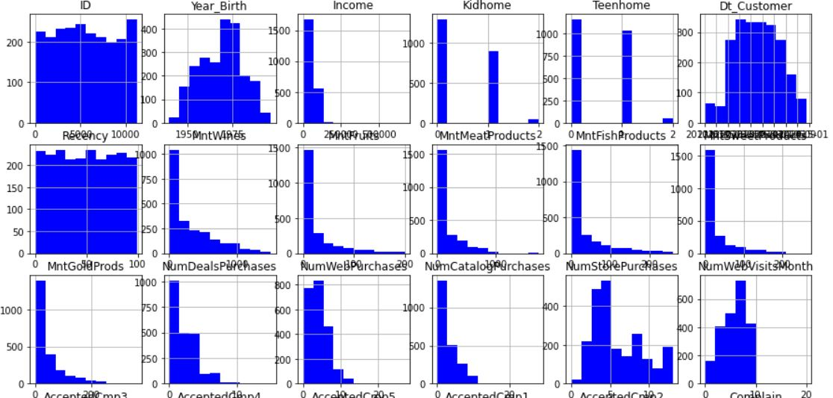
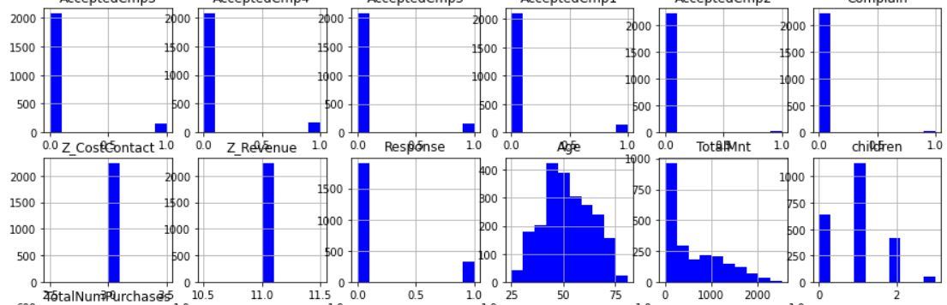
Pair plots of customer personality response with respective to remaining attributes

Slide 6
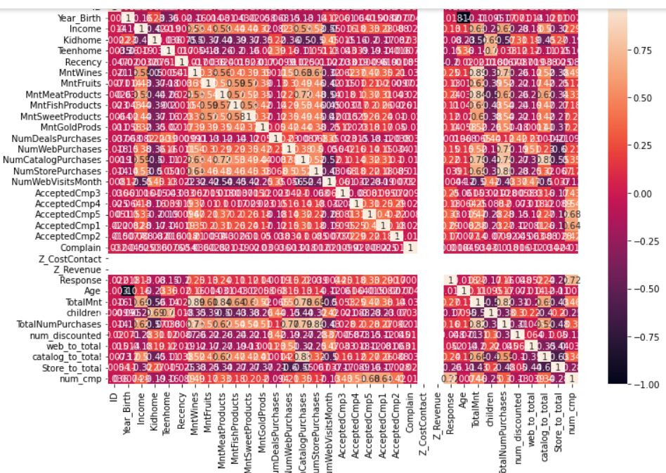
EDA insights
Correlation check

Slide 7
METHODOLOGY
Logistic Regression
Logistic regression, despite its name, is a classification model rather than regression model
Logistic regression is a simple and more efficient method for binary and linear classification problems.
It is a classification model, which is very easy to realize and achieves very good performance with linearly separable classes.
It is an extensively employed algorithm for classification in industry.

Slide 8
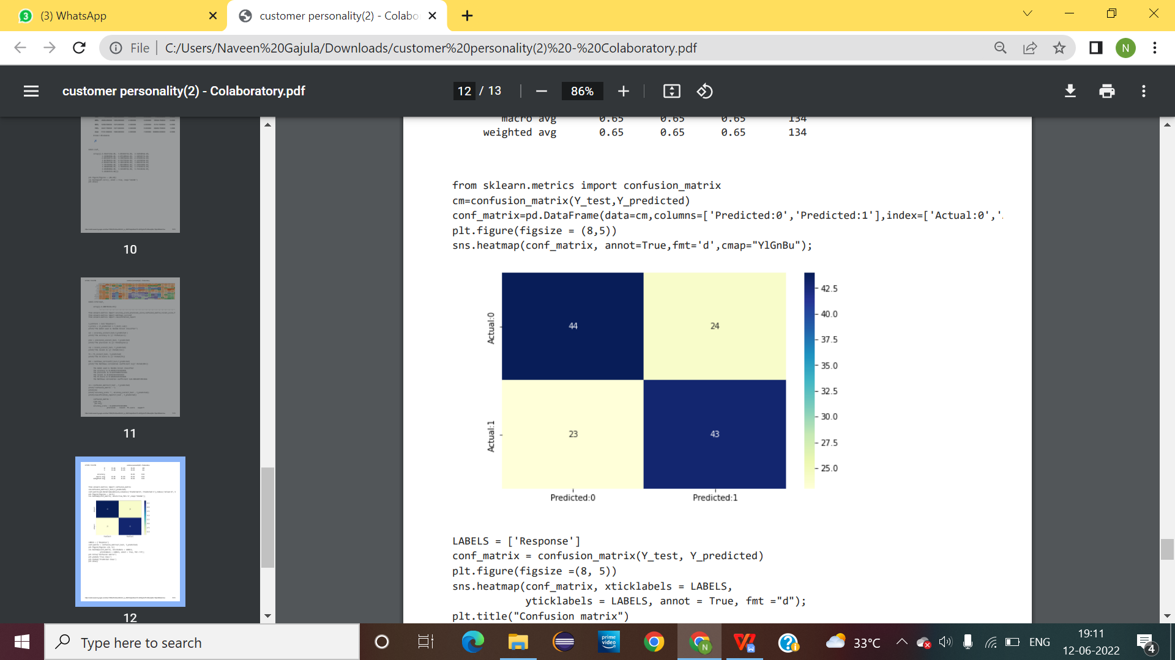

Slide 9
Random Forest
A random forest is a machine learning technique that’s used to solve regression and classification problems
A random forest utilizes ensemble learning, which is a technique that combines many classifiers to provide solutions to complex problems.
utilizes ensemble learning, which is a technique that combines many classifiers to provide solutions to complex problems.
A random forest eradicates the limitations of a decision tree algorithm. It reduces the overfitting of datasets and increases precision.

Slide 10
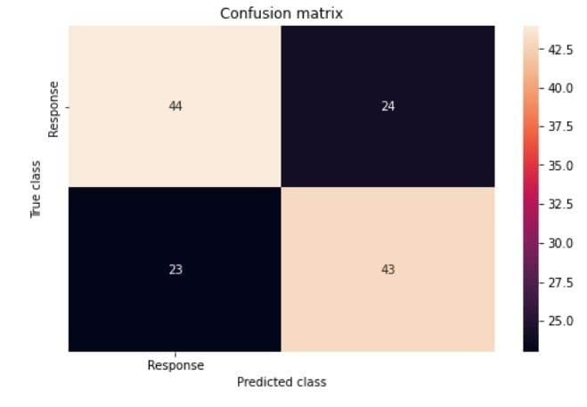

Slide 11
Summary and recommendations
Customer personality dataset is collection of 2240 rows and 29 columns it consists of attributes like income , education , marital status , etc.
We were able to find relationship(either positively correlated or negatively correlated)between the attributes.
To predict the customer personality logistics regression method is used.

Slide 12
References :-
for dataset :- https://www.kaggle.com/datasets/imakash3011/customer-personality-analysis
Code link :- https://colab.research.google.com/drive/1IjHdMU3YobjYyT6hJG082_muay54UdNx

Slide 13
Conclusion
To summarize my findings, I found that there is no correlation between year of birth and amount spent on wine, the biggest customers of wine are those with a graduate degree, and the biggest customers of wine are those with an average income of around $70,000.
As for future work, I would take an open-ended approach to this analysis as I limited the number of attributes for this project. The number of traits that can potentially have an effect on the sale of various items is extensive. Variables that could be looked into further include but are definitely not limited to the source of the purchase of wine, number of people per household, or the purchase of other items having an effect on each other. I would like to explore all of these traits and look more into depth of the various correlations with not only the sale of wine but all of the other products included in the dataset as well; incorporating different algorithms, clustering techniques, and additional plots.

